Slide 1
MTA Train AnalySIS for Wtwy gala.
METIS DATA SCIENCE
SEPTEMBER 24, 2020
BETHANY BAUMANN
MARCOS DOMINGUEZ
GURUNADH PARINANDI
PETER PRUDHOMME

Slide 2

MOTIVATION
Collect email addresses of people interested in the WTWY organization and gala.
OBJECTIVE
Determine where and when to place marketing teams at subway stations within New York City.

Slide 3
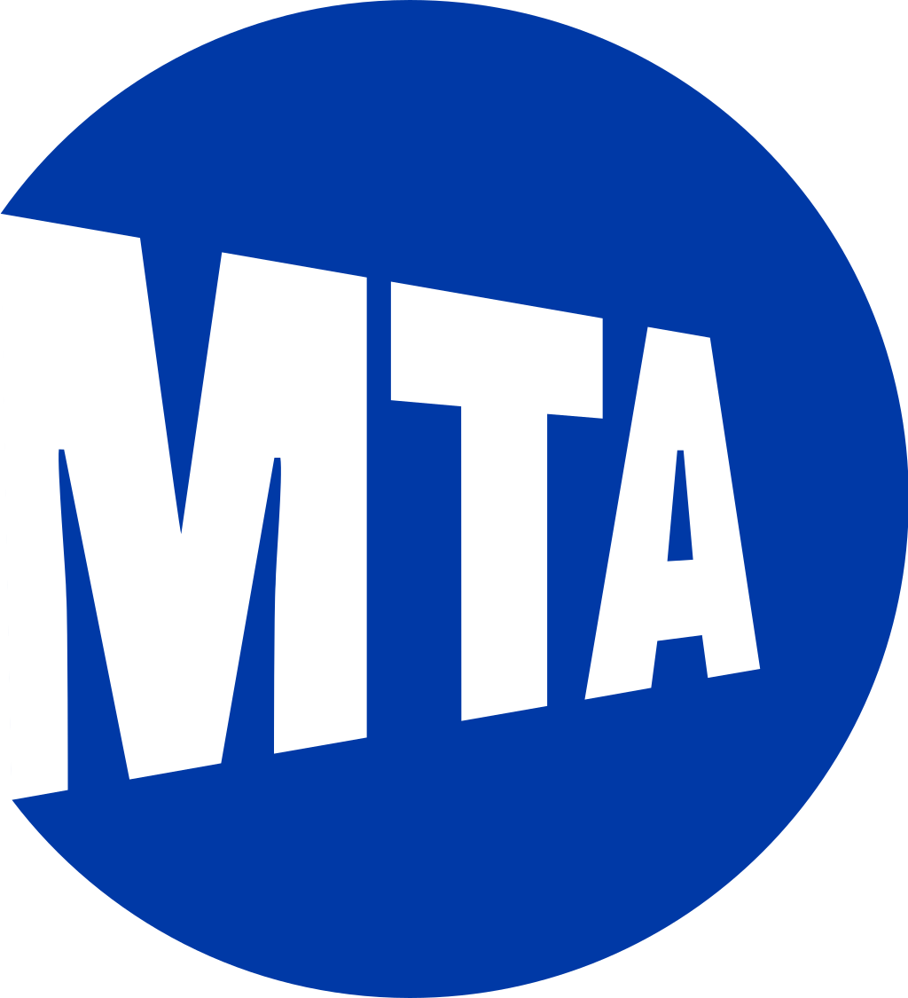
METHODOLOGY
Used publicly available MTA turnstile and location data (http://web.mta.info/developers).
Due to COVID, we utilized 2019 data (rather than 2020 data) to make our recommendations.
Data is analyzed between June 1,2019 TO August 30,2019.
Focused our analysis on the busiest ten stations within the NYC subway system.

Slide 4
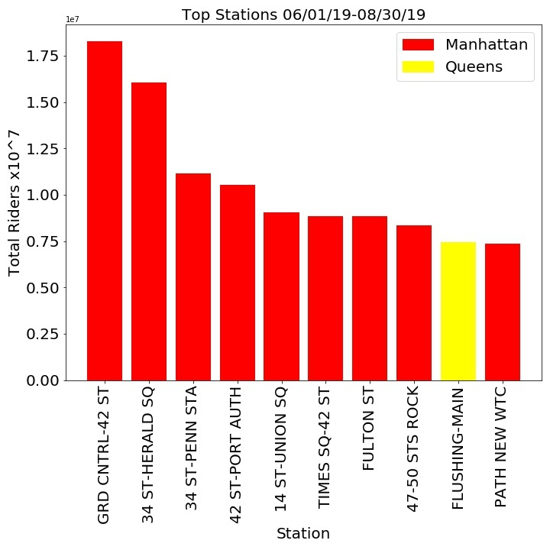
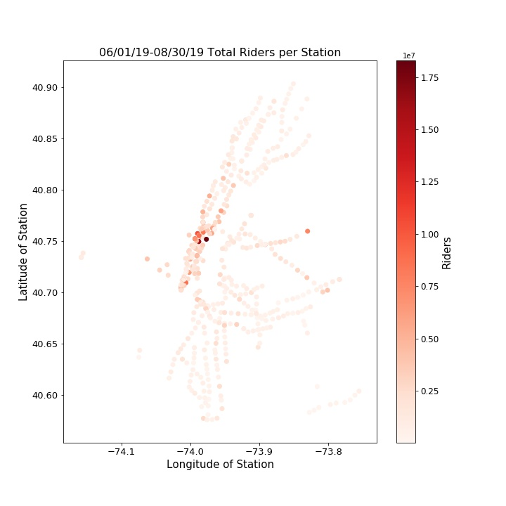
TOTAL RIDERS – SUMMER 2019

Slide 5
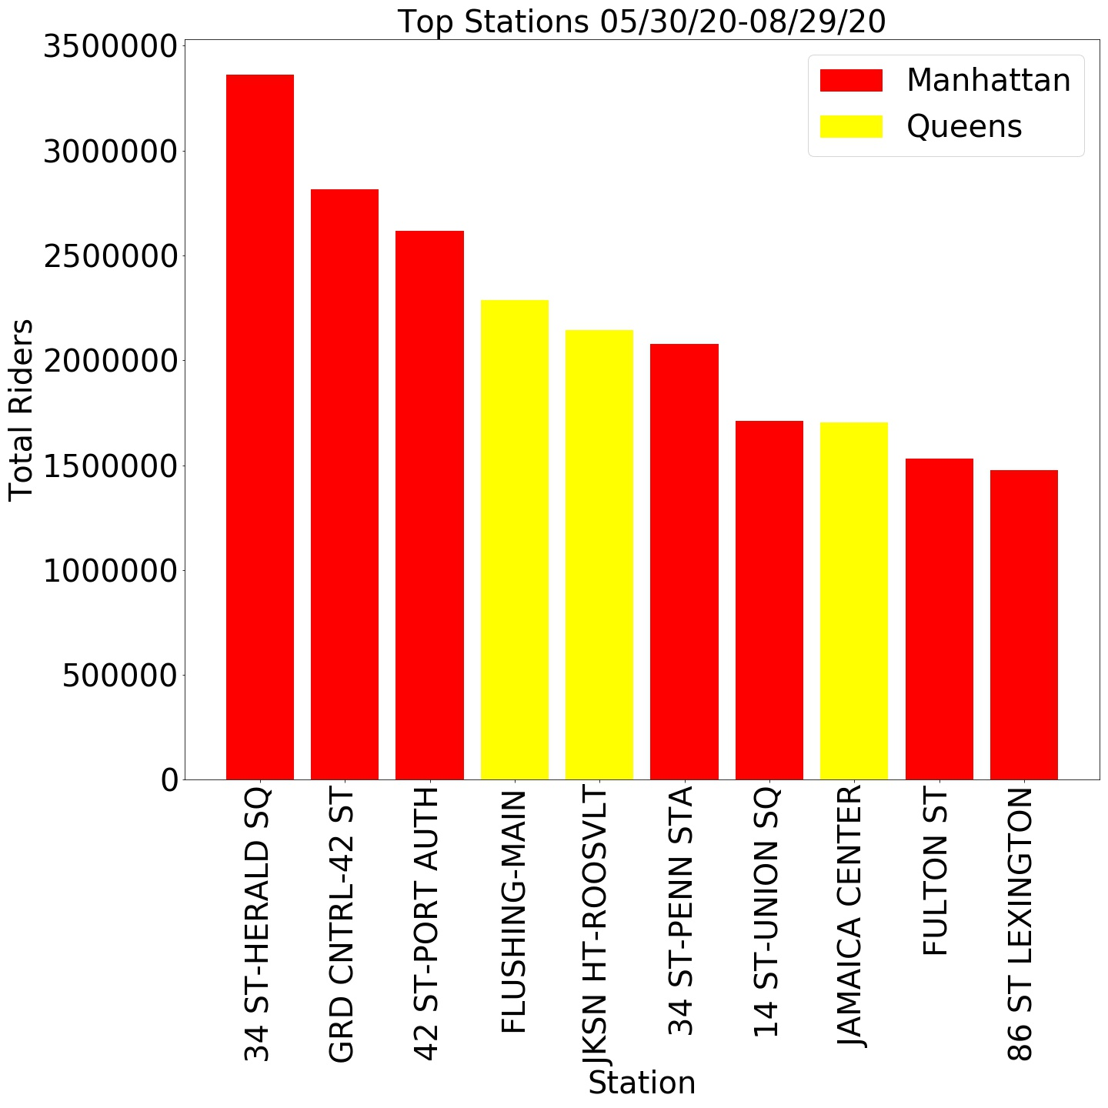
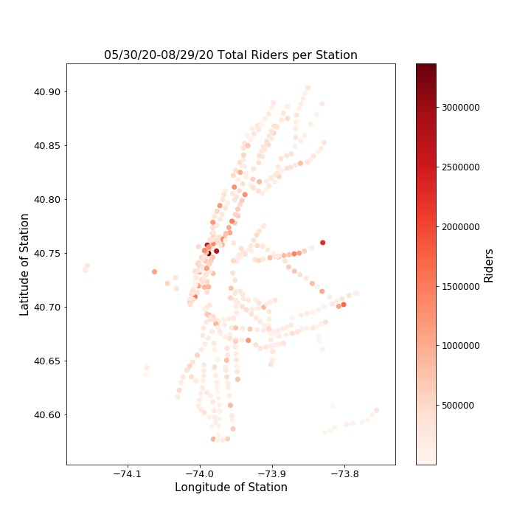
TOTAL RIDERS – SUMMER 2020

Slide 6
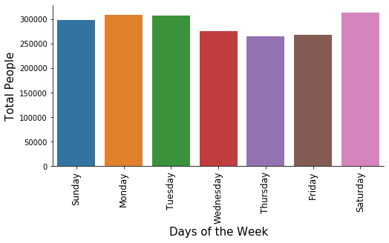
TOTAL DAILY RIDERS – SUMMER 2019

Slide 7
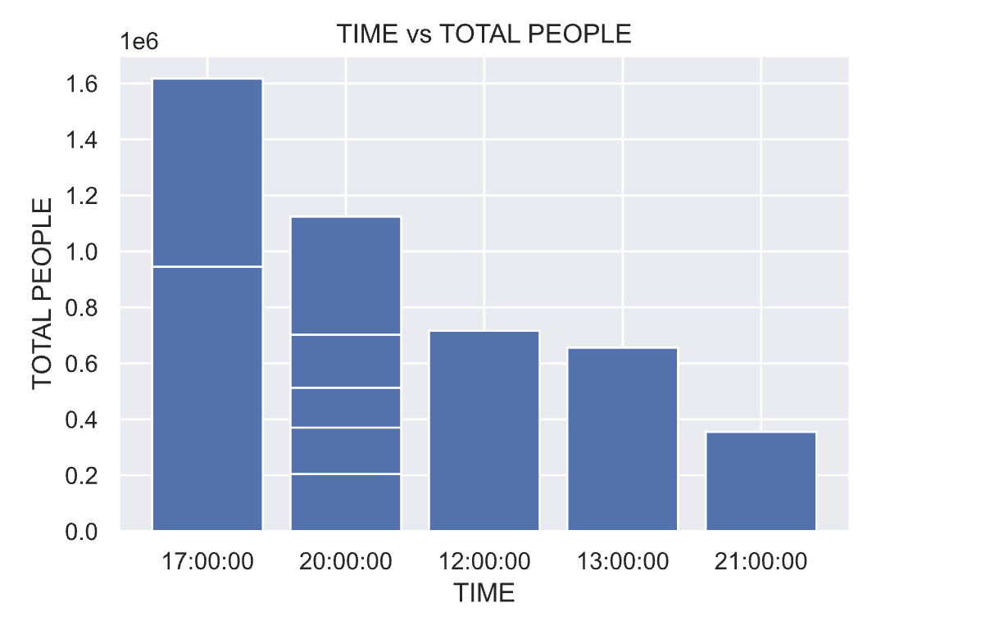
HOURLY RIDERS - SUMMER 2019 * TOP TEN BUSIEST STATIONS

Slide 8
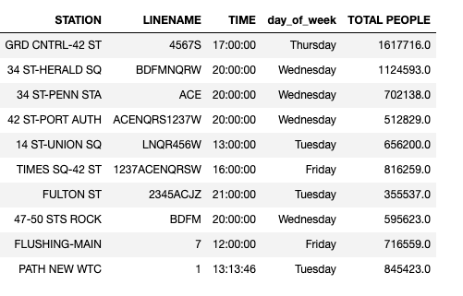
HOURLY RIDERS - SUMMER 2019 * TOP TEN BUSIEST STATIONS

Slide 9
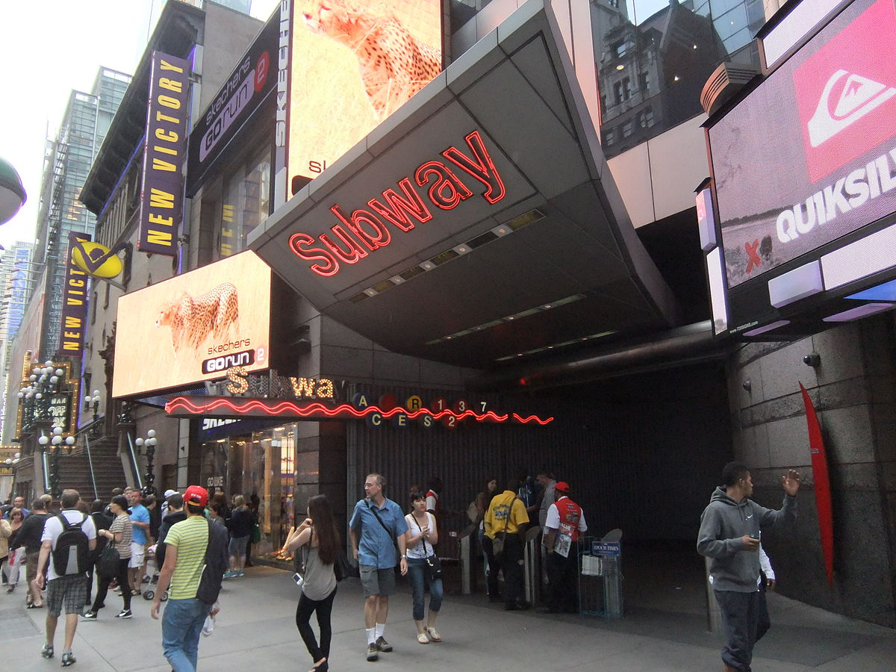
CONCLUSIONS
Grand Central-42 St. and 34 St.-Herald Sq. are the busiest Subway Stations during the summer of 2019 and 2020.
Saturday is the most popular weekday to ride the subway.
During Tuesday through Friday, the top ten stations experience the highest traffic.
Place street teams outside the top ten busiest stations on days and times suggested in slide 8.

Slide 10
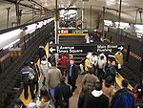
NEXT STEPS
Use station locations to find busiest stations near target social demographics and businesses.
Analyze data over the last five years in order to assess if there was growth or decline for each of the top ten stations.
Increase the number of stations analyzed.
Top ten to fifteen subway stations for each NYC borough.

